Slide 1
BIOM 7110/8110 BIOSTATISTICS
Ernő Lindner, Ph.D. (elindner@memphis.edu)
Amber Jennings, Ph.D. (jjnnings@memphis.edu)
M,W: 8:40-10:05
Ecourseware

Slide 2
Chapter-4 The special case of two groups: The t test

Slide 3
^{The special case of two groups} ^{The t test}
Commonly only two groups are compared
With multiple groups ANOVA concludes only that the results are inconsistent with the null hypothesis – does not say which group differ
Test for differences in two groups: the t test or Student’s t test
F=t²

Slide 4
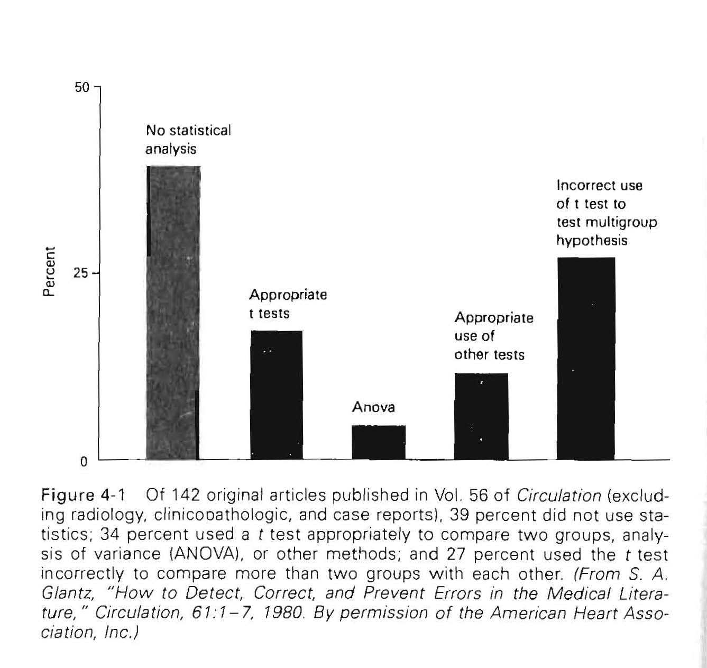
t test is the most commonly used statistical procedure
Compare two groups
Incorrectly to compare multiple groups (pairwise comparison – more than one intervention vs. single control, state of patient at different times)
Incorrect use increases the chances of rejecting the null hypothesis of no effect, i.e., increasing the chances of reporting an effect without solid statistical evidence

Slide 5
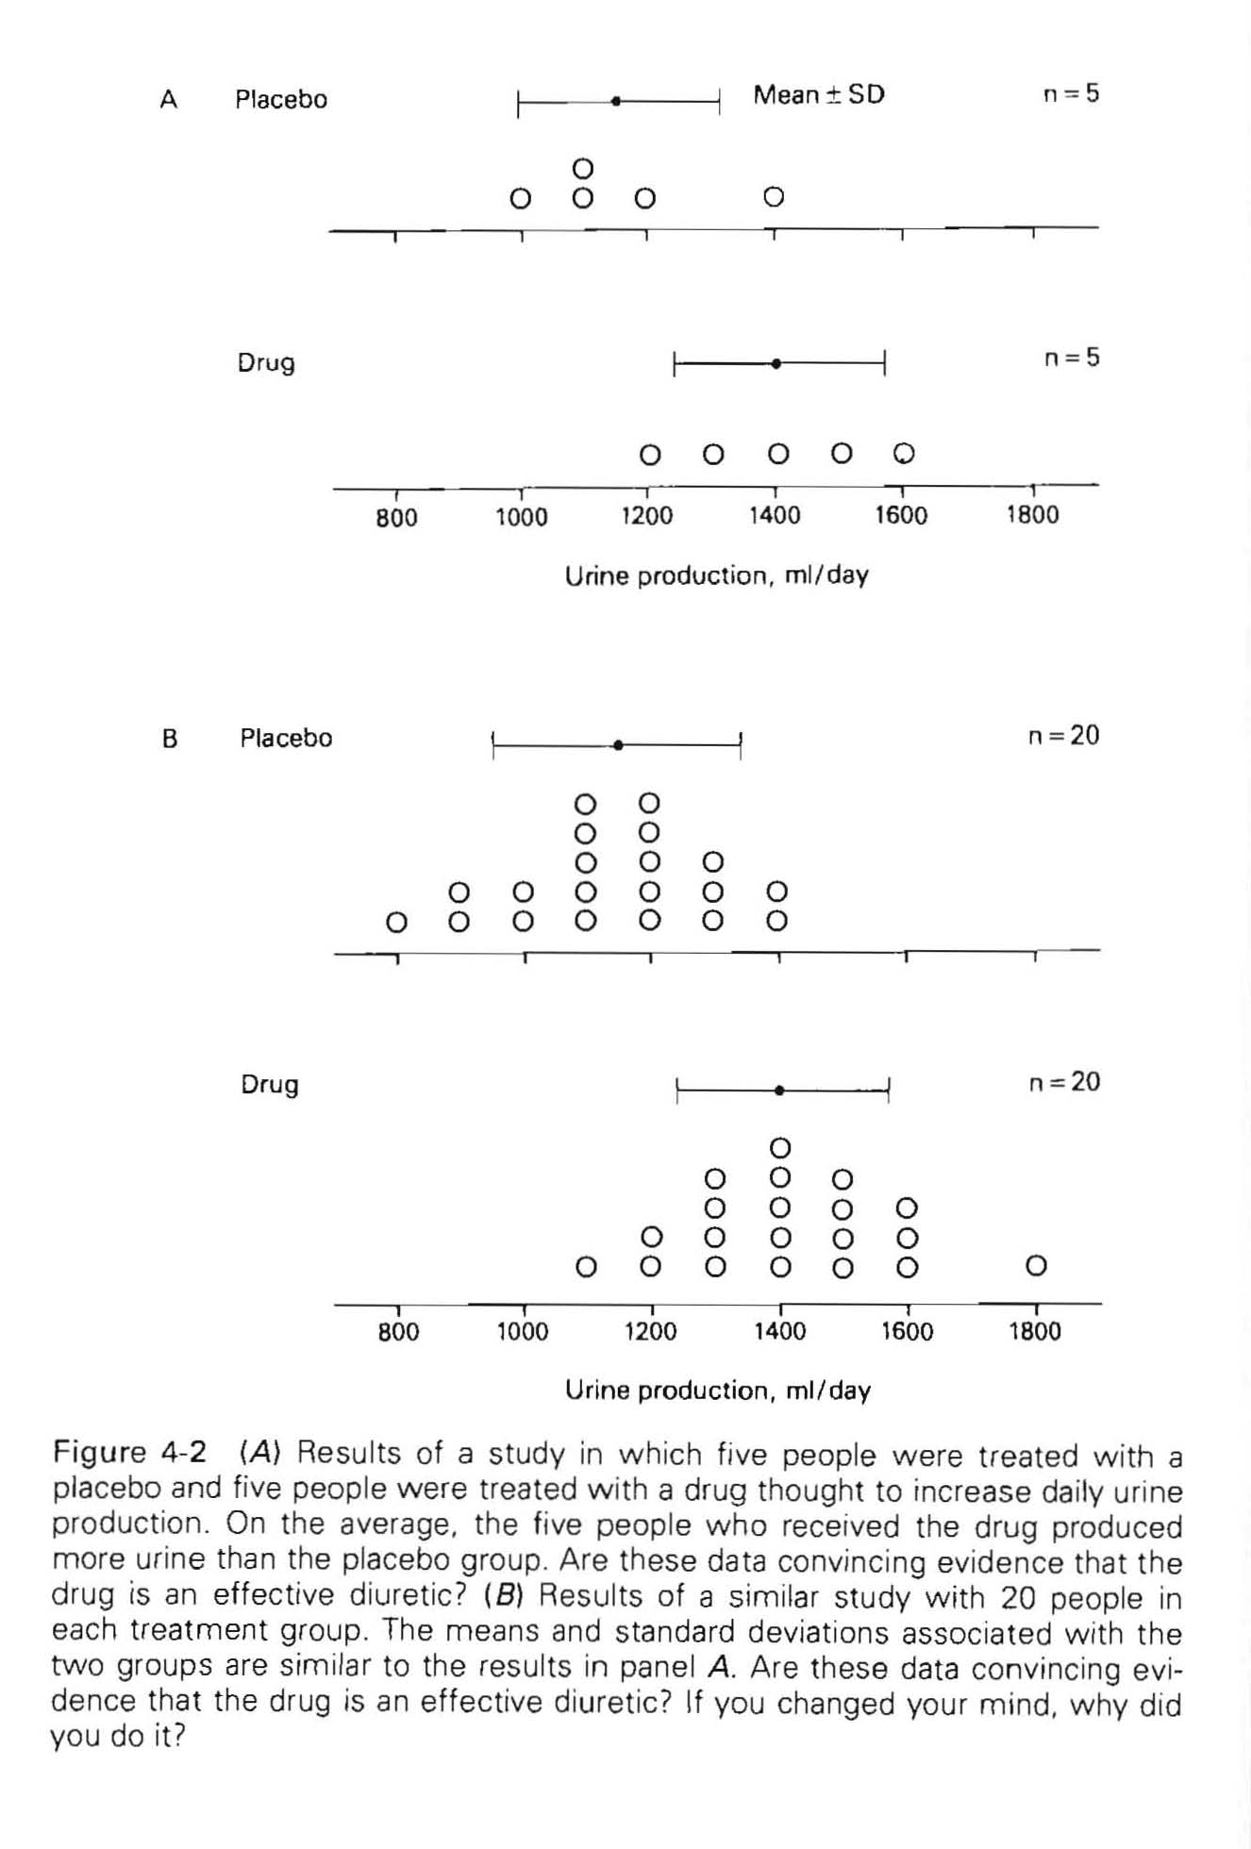
General approach:
Test a new diuretic drug
Select 10 people
Divide random in two groups
Control group: placebo
Treatment group: drug
Measure the urine production for 24 hours (Treatment -240 mL more)
Recruit 30 more people – similar results – but considered more convincing
240 mL more

Slide 6
General approach:
Standard Error of the Mean (SEM) is NOT about the standard deviation in the sample but about the certainty with which the sample mean estimates the true population mean
SEM decreases with increasing sample sizes
As the sample size increases the uncertainty in the estimate of the difference of the means between people who received placebo or the drug decreases relative to the difference between the means
240 mL more
small t – compatible with the hypothesis
large t – unlikely that the sample was drawn from a single population
Similar argument to analysis of variance (variability in means vs. variability in samples)

Slide 7
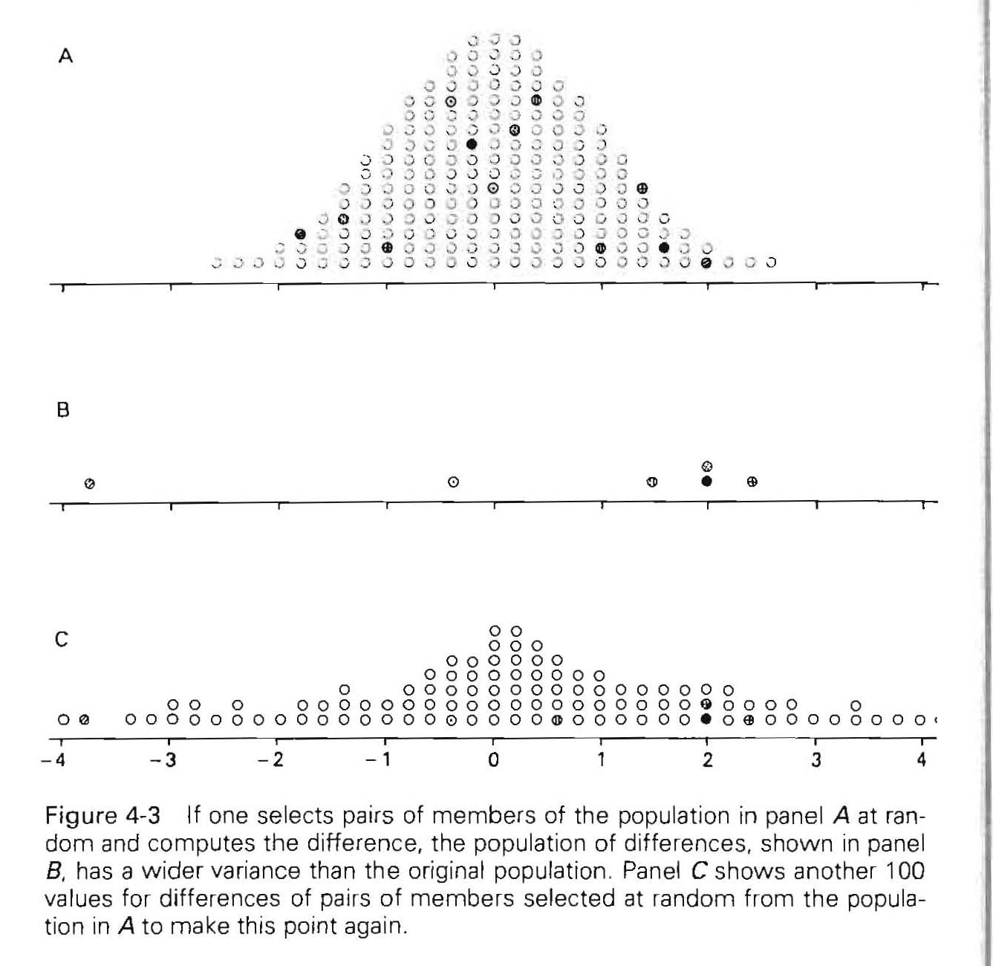




To calculate t
Propagation of uncertainty
(addition, subtraction)
$$e_{X−Y}=e_{X+Y}=\sqrt{e_{X}^{2}+e_{Y}^{2}}$$
Population
$$σ$$
Example:
N:200; Mean: 0.0; s.d.:1.0
s.d. of the difference is ~ 40% larger
Sample: X-Y (n=6)
Variances of population differences
Sample: X-Y (n=100)
s_{X-Y}$>σ$
$σ_{X−Y}=σ_{X+Y}$=$\sqrt{2}=1.4$
Variances of samples
Variances of mean differences

Slide 8
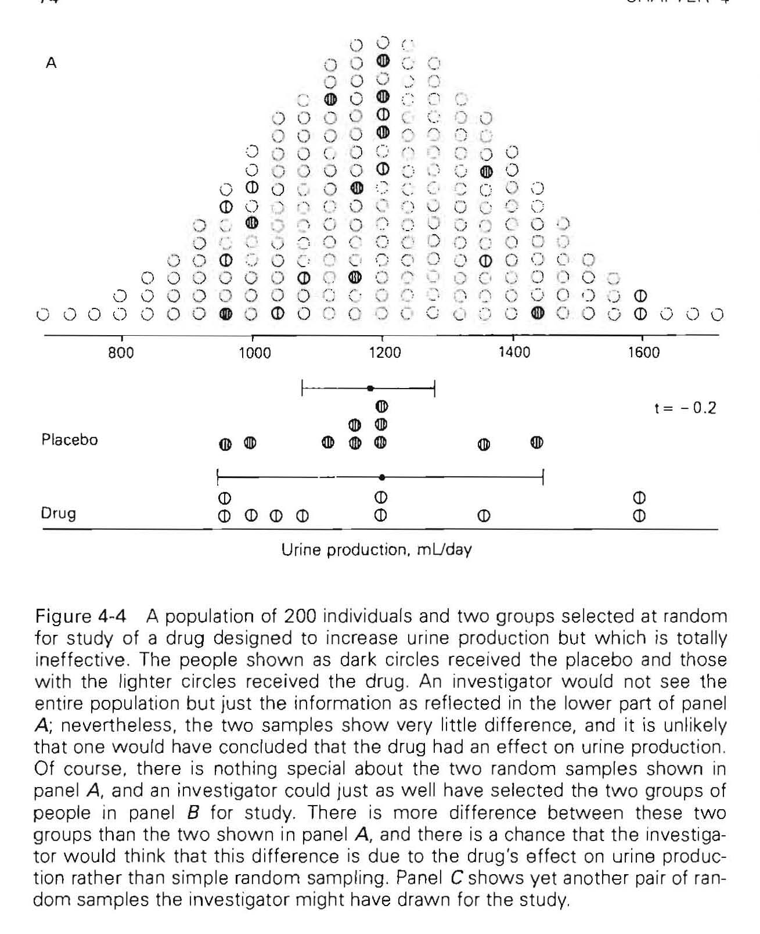
Use of t to test the hypothesis about two groups
But are both estimates of
Pooled variance estimate
Example:
N:200; n=10
Sample suggests: No effect
t – tends to be small when the samples are drawn from the same population
i.e., reject the hypothesis if t is large

Slide 9

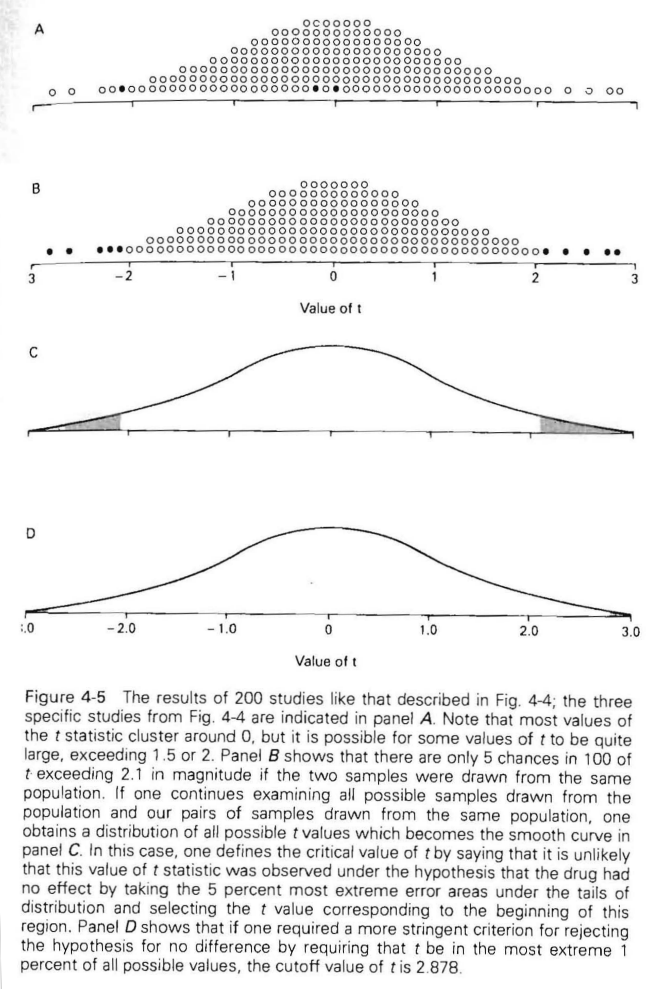
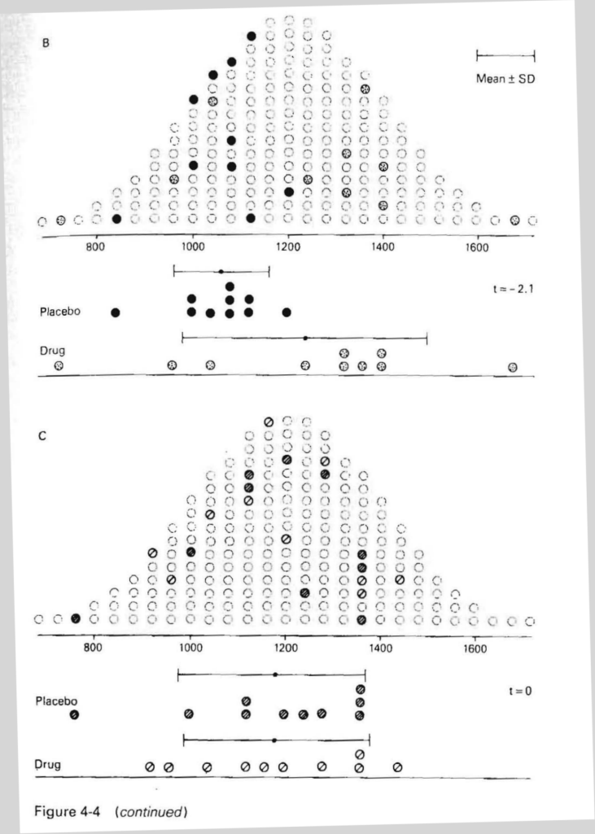
Example:
N:200;
N:10
Distribution of t values is symmetrical
Most t values between +2 and -2
5% chance that t>2.1 or t<-2.1
t=-0.2
200 pairs
t=-2.1
10^{27 pairs}
t=0.0

Slide 10
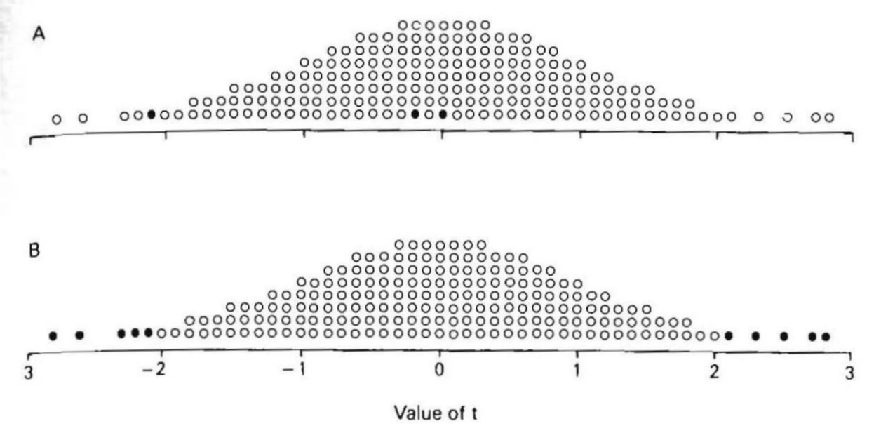
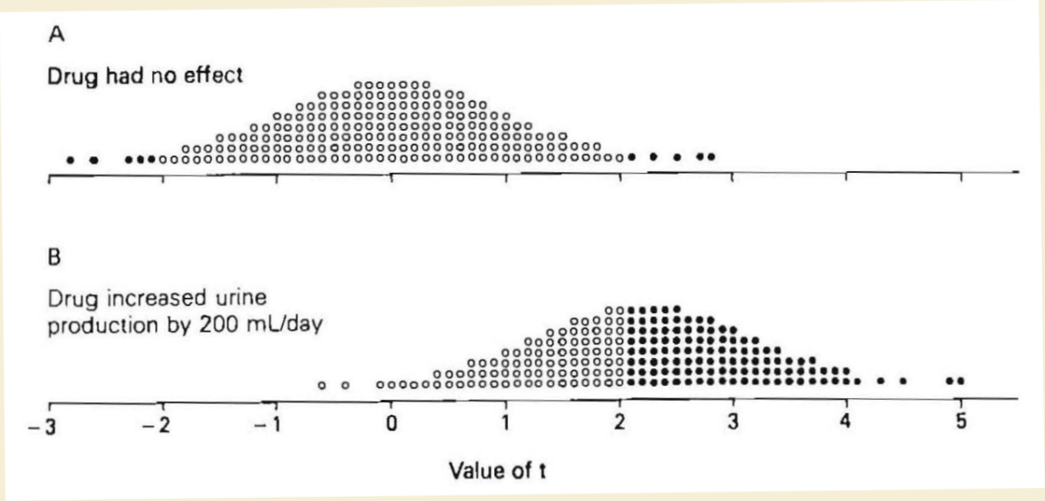
Values of t
We would conclude:
Inconsistent with the null hypothesis, i.e., drug increased the urine production
Wrong conclusion
Reporting p<0.05 means that if the treatment has no effect there is less than 5% chance that we will find t>2.1 or t<-2.1 values
We could be more conservative!
Reject the hypothesis of no effect when t is beyond 2.88 or -2.88, i.e., it would be maximum 1 % chance for reporting an effect when it were NO effect but decreases the chances for recognizing an effect

Slide 11
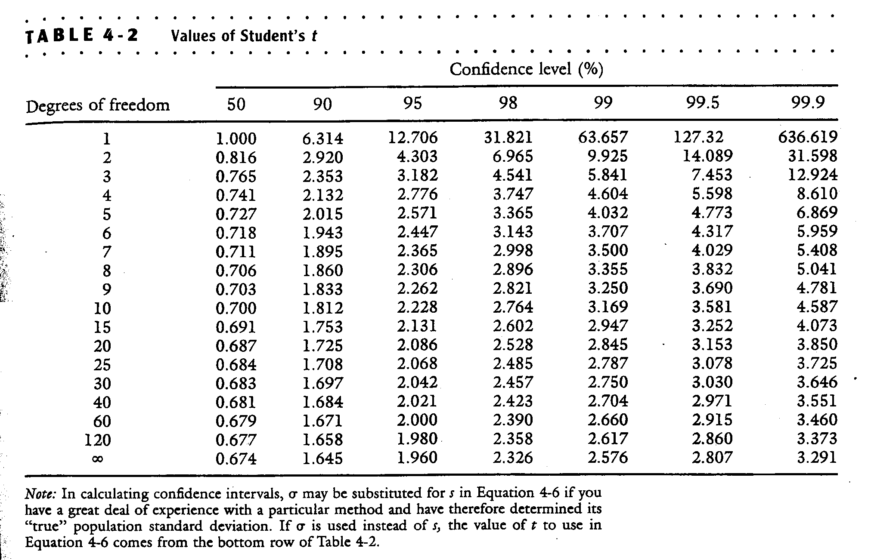
(probability of greater value, P)
(0.5)
(0.1)
(0.05)
(0.02)
(0.01)
(0.005)
(0.001)
The critical value of t depends on the level of confidence and the sample size
The sample size enters the “function” as number of freedom: ν=2(n-1)

Slide 12
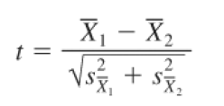

What if the two samples are not the same size?
The pooled estimate with
a degree of freedom
ν=n₁+n₂-2

Slide 13
Example-1 – observational study: DIABETES RUNS IN FAMILIES: - Insulin dependent (Children, young adults) - Insulin independent (Over 40) Can we detect abnormalities in carbohydrate metabolism non-diabetic young adults whose parents had a history of type II diabetes? Identified parents in Louisiana with history of diabetes from survey of school children - recruited children (cases) Control – offspring of similarly aged parents without history of diabetes Measured several physiologically important parameters that might be related to diabetes carbohydrate tolerance (fasting glucose, insulin….) blood pressure, cholesterol etc.

Slide 14
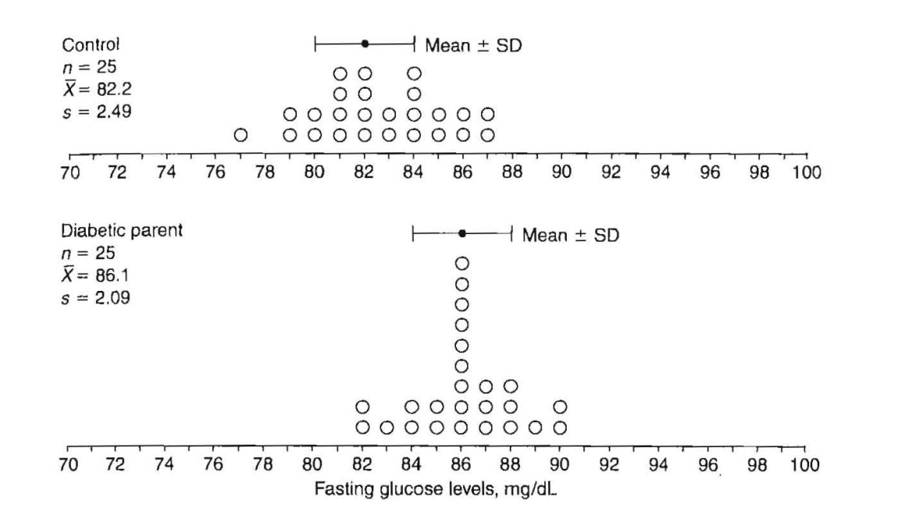
Example-1: same number of members in each group (confounding parameters similar: e.g., smoking, drinking, oral contraceptives etc.)
Fasting glucose levels:
Control: 82.2 ±2.49
Cases: 86.1±2.09 mg/L
F_{crit}(0.05)=4.04
F_{crit}(0.01)=7.19

Slide 15

Same sample size same:
Control: 82.2 ±2.49
Cases: 86.1± 2.09 mg/L
The degree of freedom
ν=2(n-1)=2(25-1)=48

Slide 16
(Confidence level %; probability of greater value, P)
80%
90%
95%
98%
99%
99.5%
99.8%
99.9%
Critical values of t
(two tailed)
ν | P | 0.20 | 0.10 | 0.05 | 0.02 | 0.01 | 0.005 | 0.002 | 0.001
1 |  | 3.078 | 6.314 | 12.706 | 31.820 | 63.657 | 127.321 | 318.309 | 636.619
2 |  | 1.886 | 2.920 | 4.303 | 6.965 | 9.925 | 14.089 | 22.327 | 31.599
3 |  | 1.638 | 2.353 | 3.182 | 4.541 | 5.841 | 7.453 | 10.215 | 12.924
4 |  | 1.533 | 2.132 | 2.776 | 3.747 | 4.604 | 5.598 | 7.173 | 8.610
5 |  | 1.476 | 2.015 | 2.571 | 3.365 | 4.032 | 4.773 | 5.893 | 6.869
6 |  | 1.440 | 1.943 | 2.447 | 3.143 | 3.707 | 4.317 | 5.208 | 5.959
7 |  | 1.415 | 1.895 | 2.365 | 2.998 | 3.499 | 4.029 | 4.785 | 5.408
8 |  | 1.397 | 1.860 | 2.306 | 2.897 | 3.355 | 3.833 | 4.501 | 5.041
9 |  | 1.383 | 1.833 | 2.262 | 2.821 | 3.250 | 3.690 | 4.297 | 4.781
10 |  | 1.372 | 1.812 | 2.228 | 2.764 | 3.169 | 3.581 | 4.144 | 4.587
11 |  | 1.363 | 1.796 | 2.201 | 2.718 | 3.106 | 3.497 | 4.025 | 4.437
12 |  | 1.356 | 1.782 | 2.179 | 2.681 | 3.055 | 3.428 | 3.930 | 4.318
13 |  | 1.350 | 1.771 | 2.160 | 2.650 | 3.012 | 3.372 | 3.852 | 4.221
14 |  | 1.345 | 1.761 | 2.145 | 2.625 | 2.977 | 3.326 | 3.787 | 4.140
15 |  | 1.341 | 1.753 | 2.131 | 2.602 | 2.947 | 3.286 | 3.733 | 4.073
16 |  | 1.337 | 1.746 | 2.120 | 2.584 | 2.921 | 3.252 | 3.686 | 4.015
17 |  | 1.333 | 1.740 | 2.110 | 2.567 | 2.898 | 3.222 | 3.646 | 3.965
18 |  | 1.330 | 1.734 | 2.101 | 2.552 | 2.878 | 3.197 | 3.610 | 3.922
19 |  | 1.328 | 1.729 | 2.093 | 2.539 | 2.861 | 3.174 | 3.579 | 3.883
20 |  | 1.325 | 1.725 | 2.086 | 2.528 | 2.845 | 3.153 | 3.552 | 3.850
21 |  | 1.323 | 1.721 | 2.080 | 2.518 | 2.831 | 3.135 | 3.527 | 3.819
22 |  | 1.321 | 1.717 | 2.074 | 2.508 | 2.819 | 3.119 | 3.505 | 3.792
23 |  | 1.319 | 1.714 | 2.069 | 2.500 | 2.807 | 3.104 | 3.485 | 3.768
24 |  | 1.318 | 1.711 | 2.064 | 2.492 | 2.797 | 3.090 | 3.467 | 3.745
25 |  | 1.316 | 1.708 | 2.060 | 2.485 | 2.787 | 3.078 | 3.450 | 3.725
The critical value of t depends on the level of confidence and the sample size
The sample size enters the “function” as number of freedom: ν=2(n-1)

Slide 17
Critical values of t
(two tailed)
t will exceed 2.011
5% of the time
t will exceed 2.682
1% of the time
We conclude that children with diabetic parents have significantly higher fasting glucose levels
(P<0.01)
Tdist(6.001,48,2)=2.5x10⁻⁷
ν | P | 0.20 | 0.10 | 0.05 | 0.02 | 0.01 | 0.005 | 0.002 | 0.001
26 |  | 1.315 | 1.706 | 2.056 | 2.479 | 2.779 | 3.067 | 3.435 | 3.707
27 |  | 1.314 | 1.703 | 2.052 | 2.473 | 2.771 | 3.057 | 3.421 | 3.690
28 |  | 1.313 | 1.701 | 2.048 | 2.467 | 2.763 | 3.047 | 3.408 | 3.674
29 |  | 1.311 | 1.699 | 2.045 | 2.462 | 2.756 | 3.038 | 3.396 | 3.659
30 |  | 1.310 | 1.697 | 2.042 | 2.457 | 2.750 | 3.030 | 3.385 | 3.646
31 |  | 1.309 | 1.695 | 2.040 | 2.453 | 2.744 | 3.022 | 3.375 | 3.633
32 |  | 1.309 | 1.694 | 2.037 | 2.449 | 2.738 | 3.015 | 3.365 | 3.622
33 |  | 1.308 | 1.692 | 2.035 | 2.445 | 2.733 | 3.008 | 3.356 | 3.611
34 |  | 1.307 | 1.691 | 2.032 | 2.441 | 2.728 | 3.002 | 3.348 | 3.601
35 |  | 1.306 | 1.690 | 2.030 | 2.438 | 2.724 | 2.996 | 3.340 | 3.591
36 |  | 1.306 | 1.688 | 2.028 | 2.434 | 2.719 | 2.991 | 3.333 | 3.582
37 |  | 1.305 | 1.687 | 2.026 | 2.431 | 2.715 | 2.985 | 3.326 | 3.574
38 |  | 1.304 | 1.686 | 2.024 | 2.429 | 2.712 | 2.980 | 3.319 | 3.566
39 |  | 1.304 | 1.685 | 2.023 | 2.426 | 2.708 | 2.976 | 3.313 | 3.558
40 |  | 1.303 | 1.684 | 2.021 | 2.423 | 2.704 | 2.971 | 3.307 | 3.551
42 |  | 1.302 | 1.682 | 2.018 | 2.418 | 2.698 | 2.963 | 3.296 | 3.538
44 |  | 1.301 | 1.680 | 2.015 | 2.414 | 2.692 | 2.956 | 3.286 | 3.526
46 |  | 1.300 | 1.679 | 2.013 | 2.410 | 2.687 | 2.949 | 3.277 | 3.515
48 |  | 1.299 | 1.677 | 2.011 | 2.407 | 2.682 | 2.943 | 3.269 | 3.505
50 |  | 1.299 | 1.676 | 2.009 | 2.403 | 2.678 | 2.937 | 3.261 | 3.496
60 |  | 1.296 | 1.671 | 2.000 | 2.390 | 2.660 | 2.915 | 3.232 | 3.460
70 |  | 1.294 | 1.667 | 1.994 | 2.381 | 2.648 | 2.899 | 3.211 | 3.435
80 |  | 1.292 | 1.664 | 1.990 | 2.374 | 2.639 | 2.887 | 3.195 | 3.416
90 |  | 1.291 | 1.662 | 1.987 | 2.369 | 2.632 | 2.878 | 3.183 | 3.402
100 |  | 1.290 | 1.660 | 1.984 | 2.364 | 2.626 | 2.871 | 3.174 | 3.391
120 |  | 1.289 | 1.658 | 1.980 | 2.358 | 2.617 | 2.860 | 3.160 | 3.373
150 |  | 1.287 | 1.655 | 1.976 | 2.351 | 2.609 | 2.849 | 3.145 | 3.357
200 |  | 1.286 | 1.652 | 1.972 | 2.345 | 2.601 | 2.839 | 3.131 | 3.340
300 |  | 1.284 | 1.650 | 1.968 | 2.339 | 2.592 | 2.828 | 3.118 | 3.323
500 |  | 1.283 | 1.648 | 1.965 | 2.334 | 2.586 | 2.820 | 3.107 | 3.310
∞ |  | 1.282 | 1.645 | 1.960 | 2.326 | 2.576 | 2.807 | 3.090 | 3.291

Slide 18
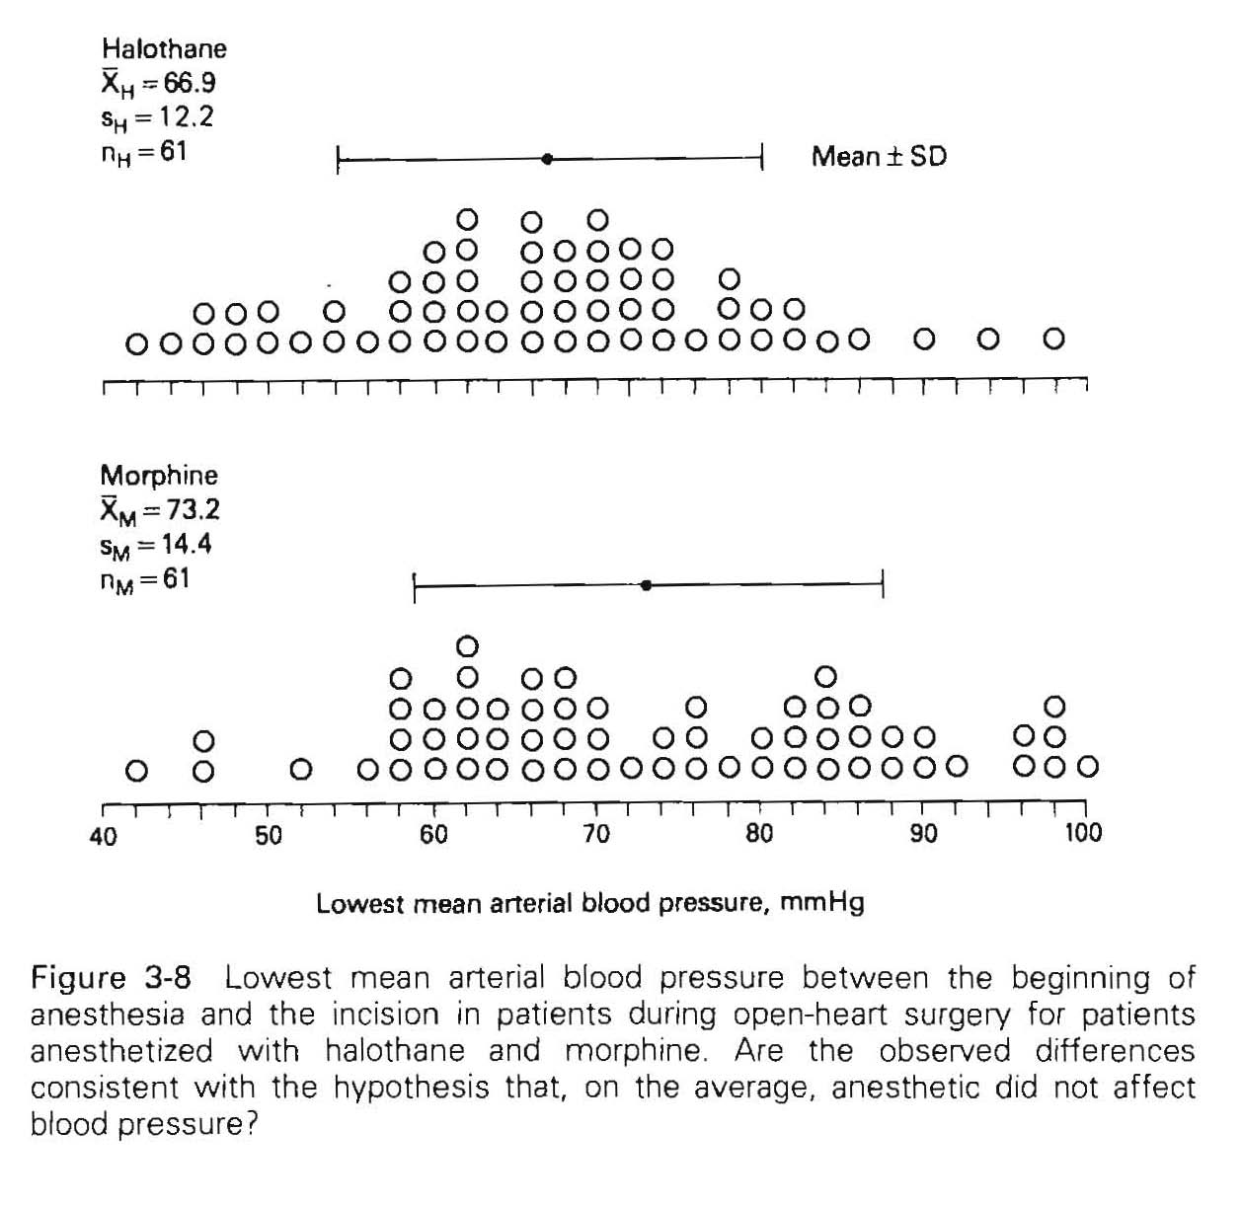

Example-2:
Is a pressure difference of Δ=6.3 mmHg
related to the difference in the anesthetic agents or related to random sampling with standard deviations ranging between 12.2 and 14.4?
Quite big overlap between the results
HALOTHANE VS MORPHINE FOR OPEN HEART SURGERY Null hypothesis: There is NO difference between the lowest mean arterial blood pressure between start of anesthesia and incision
n=61
Halothane: 66.9 ±12.2 mmHg
n=61
Morphine: 73.2 ±14.4 mmHg
F_{crit}(0.05)=4.04
F_{crit}(0.01)=7.19
F_{crit}(0.05)=3.92
F_{crit}(0.01)=6.85

Slide 19
n=61
Halothane: 66.9 ±12.2 mmHg
Same sample size same:
n=61
Morphine: 73.2 ±14.4 mmHg
F_{crit}(0.05)=4.04
F_{crit}(0.01)=7.19
The degree of freedom
ν=2(61-1)=120

Slide 20
ν | P | 0.20 | 0.10 | 0.05 | 0.02 | 0.01 | 0.005 | 0.002 | 0.001
1 |  | 3.078 | 6.314 | 12.706 | 31.820 | 63.657 | 127.321 | 318.309 | 636.619
2 |  | 1.886 | 2.920 | 4.303 | 6.965 | 9.925 | 14.089 | 22.327 | 31.599
3 |  | 1.638 | 2.353 | 3.182 | 4.541 | 5.841 | 7.453 | 10.215 | 12.924
4 |  | 1.533 | 2.132 | 2.776 | 3.747 | 4.604 | 5.598 | 7.173 | 8.610
5 |  | 1.476 | 2.015 | 2.571 | 3.365 | 4.032 | 4.773 | 5.893 | 6.869
6 |  | 1.440 | 1.943 | 2.447 | 3.143 | 3.707 | 4.317 | 5.208 | 5.959
7 |  | 1.415 | 1.895 | 2.365 | 2.998 | 3.499 | 4.029 | 4.785 | 5.408
8 |  | 1.397 | 1.860 | 2.306 | 2.897 | 3.355 | 3.833 | 4.501 | 5.041
9 |  | 1.383 | 1.833 | 2.262 | 2.821 | 3.250 | 3.690 | 4.297 | 4.781
10 |  | 1.372 | 1.812 | 2.228 | 2.764 | 3.169 | 3.581 | 4.144 | 4.587
11 |  | 1.363 | 1.796 | 2.201 | 2.718 | 3.106 | 3.497 | 4.025 | 4.437
12 |  | 1.356 | 1.782 | 2.179 | 2.681 | 3.055 | 3.428 | 3.930 | 4.318
13 |  | 1.350 | 1.771 | 2.160 | 2.650 | 3.012 | 3.372 | 3.852 | 4.221
14 |  | 1.345 | 1.761 | 2.145 | 2.625 | 2.977 | 3.326 | 3.787 | 4.140
15 |  | 1.341 | 1.753 | 2.131 | 2.602 | 2.947 | 3.286 | 3.733 | 4.073
16 |  | 1.337 | 1.746 | 2.120 | 2.584 | 2.921 | 3.252 | 3.686 | 4.015
17 |  | 1.333 | 1.740 | 2.110 | 2.567 | 2.898 | 3.222 | 3.646 | 3.965
18 |  | 1.330 | 1.734 | 2.101 | 2.552 | 2.878 | 3.197 | 3.610 | 3.922
19 |  | 1.328 | 1.729 | 2.093 | 2.539 | 2.861 | 3.174 | 3.579 | 3.883
20 |  | 1.325 | 1.725 | 2.086 | 2.528 | 2.845 | 3.153 | 3.552 | 3.850
21 |  | 1.323 | 1.721 | 2.080 | 2.518 | 2.831 | 3.135 | 3.527 | 3.819
22 |  | 1.321 | 1.717 | 2.074 | 2.508 | 2.819 | 3.119 | 3.505 | 3.792
23 |  | 1.319 | 1.714 | 2.069 | 2.500 | 2.807 | 3.104 | 3.485 | 3.768
24 |  | 1.318 | 1.711 | 2.064 | 2.492 | 2.797 | 3.090 | 3.467 | 3.745
25 |  | 1.316 | 1.708 | 2.060 | 2.485 | 2.787 | 3.078 | 3.450 | 3.725
Critical values of t
(two tailed)

Slide 21
Critical values of t
(two tailed)
t will exceed 1.980
5% of the time
t will exceed 2.358
2% of the time
Since t exceeds this value we conclude that halothane is associated with lower lowest mean arterial pressure
ν | P | 0.20 | 0.10 | 0.05 | 0.02 | 0.01 | 0.005 | 0.002 | 0.001
26 |  | 1.315 | 1.706 | 2.056 | 2.479 | 2.779 | 3.067 | 3.435 | 3.707
27 |  | 1.314 | 1.703 | 2.052 | 2.473 | 2.771 | 3.057 | 3.421 | 3.690
28 |  | 1.313 | 1.701 | 2.048 | 2.467 | 2.763 | 3.047 | 3.408 | 3.674
29 |  | 1.311 | 1.699 | 2.045 | 2.462 | 2.756 | 3.038 | 3.396 | 3.659
30 |  | 1.310 | 1.697 | 2.042 | 2.457 | 2.750 | 3.030 | 3.385 | 3.646
31 |  | 1.309 | 1.695 | 2.040 | 2.453 | 2.744 | 3.022 | 3.375 | 3.633
32 |  | 1.309 | 1.694 | 2.037 | 2.449 | 2.738 | 3.015 | 3.365 | 3.622
33 |  | 1.308 | 1.692 | 2.035 | 2.445 | 2.733 | 3.008 | 3.356 | 3.611
34 |  | 1.307 | 1.691 | 2.032 | 2.441 | 2.728 | 3.002 | 3.348 | 3.601
35 |  | 1.306 | 1.690 | 2.030 | 2.438 | 2.724 | 2.996 | 3.340 | 3.591
36 |  | 1.306 | 1.688 | 2.028 | 2.434 | 2.719 | 2.991 | 3.333 | 3.582
37 |  | 1.305 | 1.687 | 2.026 | 2.431 | 2.715 | 2.985 | 3.326 | 3.574
38 |  | 1.304 | 1.686 | 2.024 | 2.429 | 2.712 | 2.980 | 3.319 | 3.566
39 |  | 1.304 | 1.685 | 2.023 | 2.426 | 2.708 | 2.976 | 3.313 | 3.558
40 |  | 1.303 | 1.684 | 2.021 | 2.423 | 2.704 | 2.971 | 3.307 | 3.551
42 |  | 1.302 | 1.682 | 2.018 | 2.418 | 2.698 | 2.963 | 3.296 | 3.538
44 |  | 1.301 | 1.680 | 2.015 | 2.414 | 2.692 | 2.956 | 3.286 | 3.526
46 |  | 1.300 | 1.679 | 2.013 | 2.410 | 2.687 | 2.949 | 3.277 | 3.515
48 |  | 1.299 | 1.677 | 2.011 | 2.407 | 2.682 | 2.943 | 3.269 | 3.505
50 |  | 1.299 | 1.676 | 2.009 | 2.403 | 2.678 | 2.937 | 3.261 | 3.496
60 |  | 1.296 | 1.671 | 2.000 | 2.390 | 2.660 | 2.915 | 3.232 | 3.460
70 |  | 1.294 | 1.667 | 1.994 | 2.381 | 2.648 | 2.899 | 3.211 | 3.435
80 |  | 1.292 | 1.664 | 1.990 | 2.374 | 2.639 | 2.887 | 3.195 | 3.416
90 |  | 1.291 | 1.662 | 1.987 | 2.369 | 2.632 | 2.878 | 3.183 | 3.402
100 |  | 1.290 | 1.660 | 1.984 | 2.364 | 2.626 | 2.871 | 3.174 | 3.391
120 |  | 1.289 | 1.658 | 1.980 | 2.358 | 2.617 | 2.860 | 3.160 | 3.373
150 |  | 1.287 | 1.655 | 1.976 | 2.351 | 2.609 | 2.849 | 3.145 | 3.357
200 |  | 1.286 | 1.652 | 1.972 | 2.345 | 2.601 | 2.839 | 3.131 | 3.340
300 |  | 1.284 | 1.650 | 1.968 | 2.339 | 2.592 | 2.828 | 3.118 | 3.323
500 |  | 1.283 | 1.648 | 1.965 | 2.334 | 2.586 | 2.820 | 3.107 | 3.310
∞ |  | 1.282 | 1.645 | 1.960 | 2.326 | 2.576 | 2.807 | 3.090 | 3.291
EXCEL: tdist(2.067,120,2)=0.041)

Slide 22
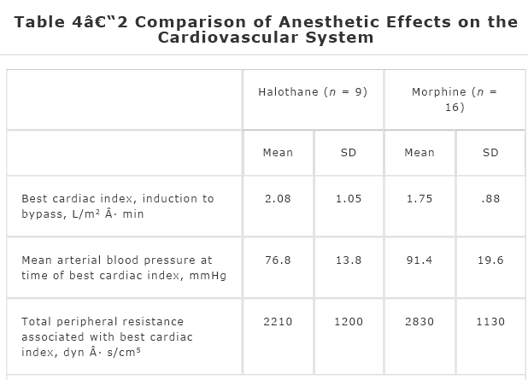
Example-2/2:
HALOTHANE VS MORPHINE FOR OPEN HEART SURGERY
Besides the mean arterial blood pressure the normalized amount of blood pumped = cardiac index
(blood volume/surface area)
Null hypothesis: There is NO difference between the cardiac index
/
The pooled estimate of s²
degree of freedom
ν=n₁+n₂-2=9+16-2=23
t_{crit}=2.069 (tinv(0.05,23)
Not enough evidence for rejecting the null hypothesis
TDIST(0.84,23,2)=0.4096

Slide 23
ν | P | 0.20 | 0.10 | 0.05 | 0.02 | 0.01 | 0.005 | 0.002 | 0.001
1 |  | 3.078 | 6.314 | 12.706 | 31.820 | 63.657 | 127.321 | 318.309 | 636.619
2 |  | 1.886 | 2.920 | 4.303 | 6.965 | 9.925 | 14.089 | 22.327 | 31.599
3 |  | 1.638 | 2.353 | 3.182 | 4.541 | 5.841 | 7.453 | 10.215 | 12.924
4 |  | 1.533 | 2.132 | 2.776 | 3.747 | 4.604 | 5.598 | 7.173 | 8.610
5 |  | 1.476 | 2.015 | 2.571 | 3.365 | 4.032 | 4.773 | 5.893 | 6.869
6 |  | 1.440 | 1.943 | 2.447 | 3.143 | 3.707 | 4.317 | 5.208 | 5.959
7 |  | 1.415 | 1.895 | 2.365 | 2.998 | 3.499 | 4.029 | 4.785 | 5.408
8 |  | 1.397 | 1.860 | 2.306 | 2.897 | 3.355 | 3.833 | 4.501 | 5.041
9 |  | 1.383 | 1.833 | 2.262 | 2.821 | 3.250 | 3.690 | 4.297 | 4.781
10 |  | 1.372 | 1.812 | 2.228 | 2.764 | 3.169 | 3.581 | 4.144 | 4.587
11 |  | 1.363 | 1.796 | 2.201 | 2.718 | 3.106 | 3.497 | 4.025 | 4.437
12 |  | 1.356 | 1.782 | 2.179 | 2.681 | 3.055 | 3.428 | 3.930 | 4.318
13 |  | 1.350 | 1.771 | 2.160 | 2.650 | 3.012 | 3.372 | 3.852 | 4.221
14 |  | 1.345 | 1.761 | 2.145 | 2.625 | 2.977 | 3.326 | 3.787 | 4.140
15 |  | 1.341 | 1.753 | 2.131 | 2.602 | 2.947 | 3.286 | 3.733 | 4.073
16 |  | 1.337 | 1.746 | 2.120 | 2.584 | 2.921 | 3.252 | 3.686 | 4.015
17 |  | 1.333 | 1.740 | 2.110 | 2.567 | 2.898 | 3.222 | 3.646 | 3.965
18 |  | 1.330 | 1.734 | 2.101 | 2.552 | 2.878 | 3.197 | 3.610 | 3.922
19 |  | 1.328 | 1.729 | 2.093 | 2.539 | 2.861 | 3.174 | 3.579 | 3.883
20 |  | 1.325 | 1.725 | 2.086 | 2.528 | 2.845 | 3.153 | 3.552 | 3.850
21 |  | 1.323 | 1.721 | 2.080 | 2.518 | 2.831 | 3.135 | 3.527 | 3.819
22 |  | 1.321 | 1.717 | 2.074 | 2.508 | 2.819 | 3.119 | 3.505 | 3.792
23 |  | 1.319 | 1.714 | 2.069 | 2.500 | 2.807 | 3.104 | 3.485 | 3.768
24 |  | 1.318 | 1.711 | 2.064 | 2.492 | 2.797 | 3.090 | 3.467 | 3.745
25 |  | 1.316 | 1.708 | 2.060 | 2.485 | 2.787 | 3.078 | 3.450 | 3.725
Critical values of t
(two tailed)

Slide 24
Children with parents who has diabetes 5% (1%)
Halothane vs. morphine anesthesia 5% (1%)
n=25
x₁=82.2 x₂=86.1
s₁=2.49 s₂=2.09
F_{calc}=36.01
ν_{num}=2-1=1
ν_{denom}=2(25-1)=48
F_{table}=4.04 (7.19)
t_{calc}= 6.001
t_{table}=2.011 (2.68)
n=61
x₁=66.9 x₂=73.2
s₁=12.2 s₂=14.4
F_{calc}=6.81
ν_{num}=2-1=1
ν_{denom}=2(61-1)=120
F_{table}=3.92 (6.85)
t= -2.607
t_{table}=1.98 (2.617)
ANOVA
t test
(t_{table})²=2.011²=4.04; 2.68²=7.18
(t_{calc})²=6.001²=36.01
(t_{table})²=1.98²=3.92; 2.617²=6.85
(t_{calc})²=-2.067²=6.797
F = t²

Slide 25


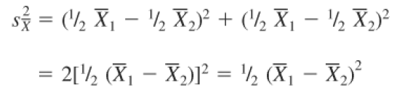
F = t²
but
=

Slide 26
Two Sample t-tests: How to proceed if the variances are not equal?
Used for comparing sample means when population standard deviations (σ₁ & σ₂) are unknown but are estimated by sample standard deviations (S₁ & S₂) and when n₁ & n₂ < 100

Slide 27
Two Sample t-tests
1. Pooled variance t-test
Assumes equal variances
Thus pool data were used to estimate of σ² via S²_{pooled} with d.f. = (n₁+ n₂ – 2)
2. Separate variance t-test
If the variances of the two means (populations) can not be assumed to be equal, must use S²₁ & S²₂ to compute t-statistic with d.f. lower than (n₁+ n₂ – 2)
With lower d.f., distribution of test statistic is associated with increased spread of sampling distribution and hence increased random sampling variation

Slide 28
Two Sample t-tests
Assumptions:
Data from each sample is obtained in random, unbiased manner
Both data distributions approximate a normal distribution ( e.g. frequency, box-plots, rules of thumb for CLT)
Rules of thumb for CLT for estimating sample size:
If population is Normal, sampling distribution will be normal and n< 15 is sufficient
Sampling distribution is Normal if have no outliers or extreme skewness,
and sample size is 15 < n < 40.
Sampling distribution is Normal if have outliers and moderate skewness with
sample size > 40.
Sampling distribution is Normal even with extreme outliers and skewness with
sample size > 100.

Slide 29
Two Sample t-tests
Pooled vs Separate Variance?
Ans: F-test
σ₁ = σ₂ ; F_{max}test = S_{larger}²/S_{smaller}² ~1.0
F_{max}table
If F_{max} ≥ F_{critical} in table, then two population variances can not be assumed to be equal and must use separate variance t-test
If F_{max} < F_{criticalmax} in table, then two populations variances can be assumed to be equal and can use pooled variance t-test

Slide 30
Two Sample t-tests
Sampling Distribution
Expected of value: (μ₁-μ₂) = 0
Spread for pooled variance

Slide 31
Two Sample t-tests
For separate variance :
For separate variances d.f._{adjusted}:

Slide 32
Two Sample t-tests
Test statistic
P-value
Probability of obtaining the observed difference between sample means if the two population means are equal, i.e. if H_{o} is true.
For one sided test, p-value = P[t ≥ +t_{test}] or
P[t ≤ -t_{test}]
For two-sided test, p-value = 2* P[t ≥ │t_{test}│]

Slide 33
Two Sample t-tests
Conclusion
If p ≤ 0.05, then the probability associated with the random sampling variation explanation for observed differences between two means is sufficiently low so the two groups are not equivalent

